Slide 1

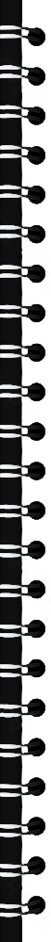
World Coin Classification Using PyTorch
In the presentation we will use pretrained model and fine-tuning techniques to make a classification model that will be able to classify 211 different classes of coins from each other
The scope of this presentation will be to cover the data , the need, methodology and the results.
Presented By
Diwanshu Jindal

Slide 2

Presentation Overview
1
Introduction to the data
We'll start by exploring the nature of our coin data and the need for this classification model.
2
Visualization
We'll then visualize our data and distribution, providing clear insights into the approach.
3
Methodology
Next, we'll dive into the technical aspects, discussing the framework, structure, and model definition..
4
Results
Finally, we'll present the outcomes of our classification system, demonstrating its effectiveness, and few other ways to improve the results

Slide 3
Introduction: Understanding the Data and Need
Understanding the Need
Understanding the Data
Visualizing the Data
With the increasing variety of coins and the need for precise classification across a large number of categories, traditional rule-based systems are no longer sufficient. There is a critical need for AI-driven coin classification models that can efficiently classify. Such models should be capable of adapting to new coin types and subtle variations, ensuring accurate and real-time classification without the need for manual intervention.
Our dataset consists of thousands of coin image samples, With 211 distinct coin classes, this high-dimensional data presents both challenges and opportunities for accurate classification. Developing a model capable of handling such diverse and complex features is crucial for precise identification and classification of each coin in real-time.
We'll explore various visualization techniques to gain insights into our data's structure and distribution.

Slide 4




Understanding the Need
1
Automatic Coin Sorting Machines
2
Coin Fraud Detection
3
Coin Authentication for uncommon coins
4
Coin Recycling

Slide 5
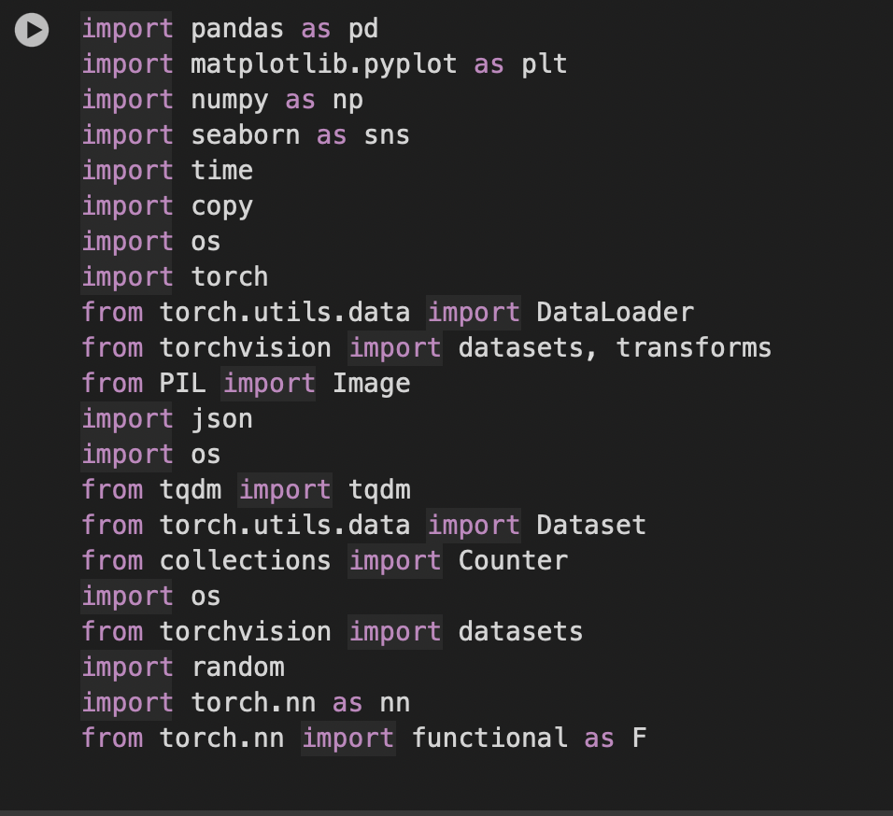
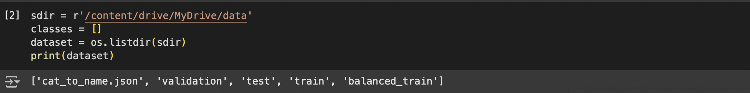
Data Ingestion
Libraries
Load the libraries required for the data ingestion, preprocessing, visualization, and model creation
Source
I have used Kaggle as the Data source for the Data. Kaggle is one of the most used and data rich opensource platform to use. Then I downloaded the data in the local system and then uploaded in the google drive from where I have used this directly.

Slide 6
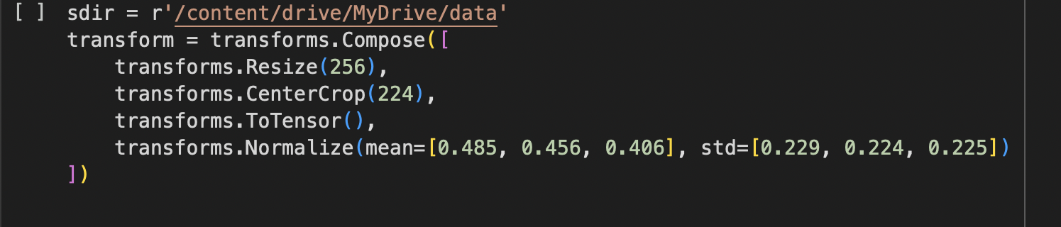
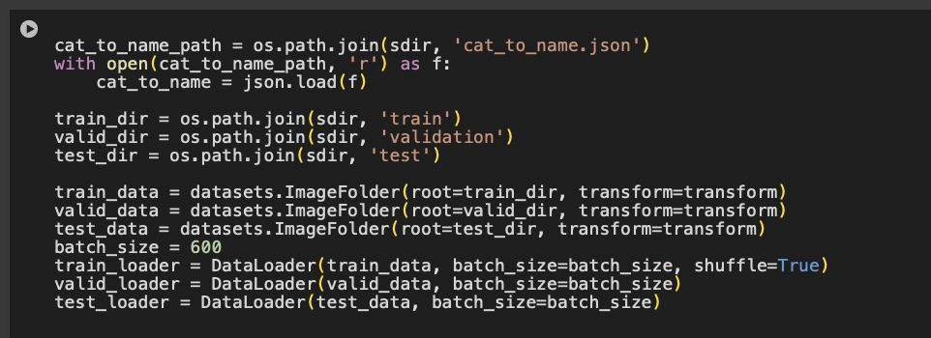
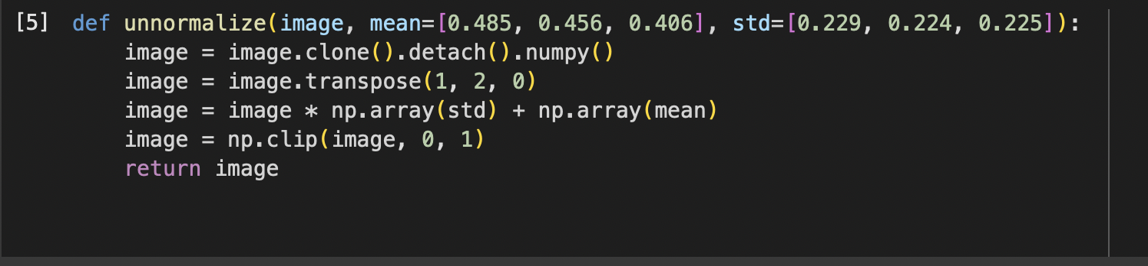
Data preprocessing
Get the data from their respective folder and load the data in a dataloader with shuffle, batch size and normalizer (predefined for the pretrained model.
These parameters can be changed as per the computational power available and the requirements for the output
To visualize the input images we need to reverse the
Normalization and then using the matplotlib plot
The inputs Un-Normalization will be the just
opposite process of normalization

Slide 7
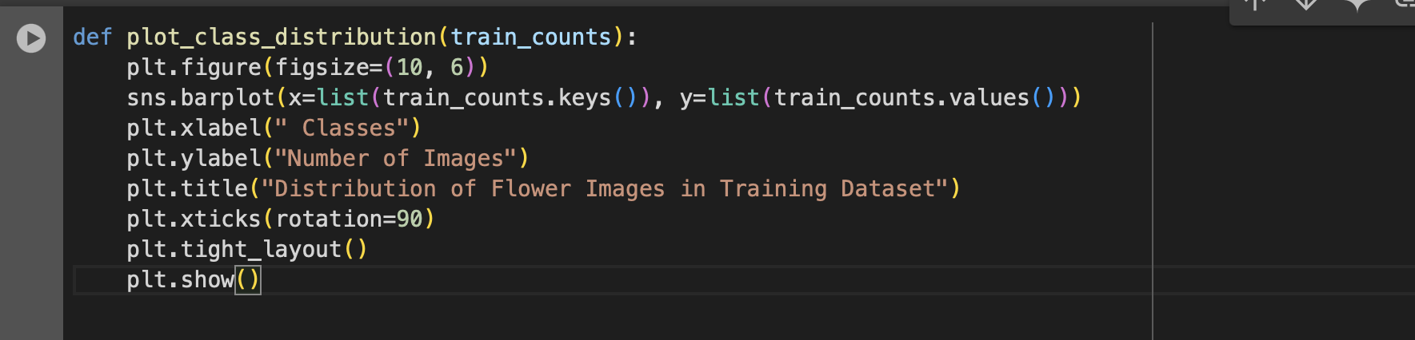
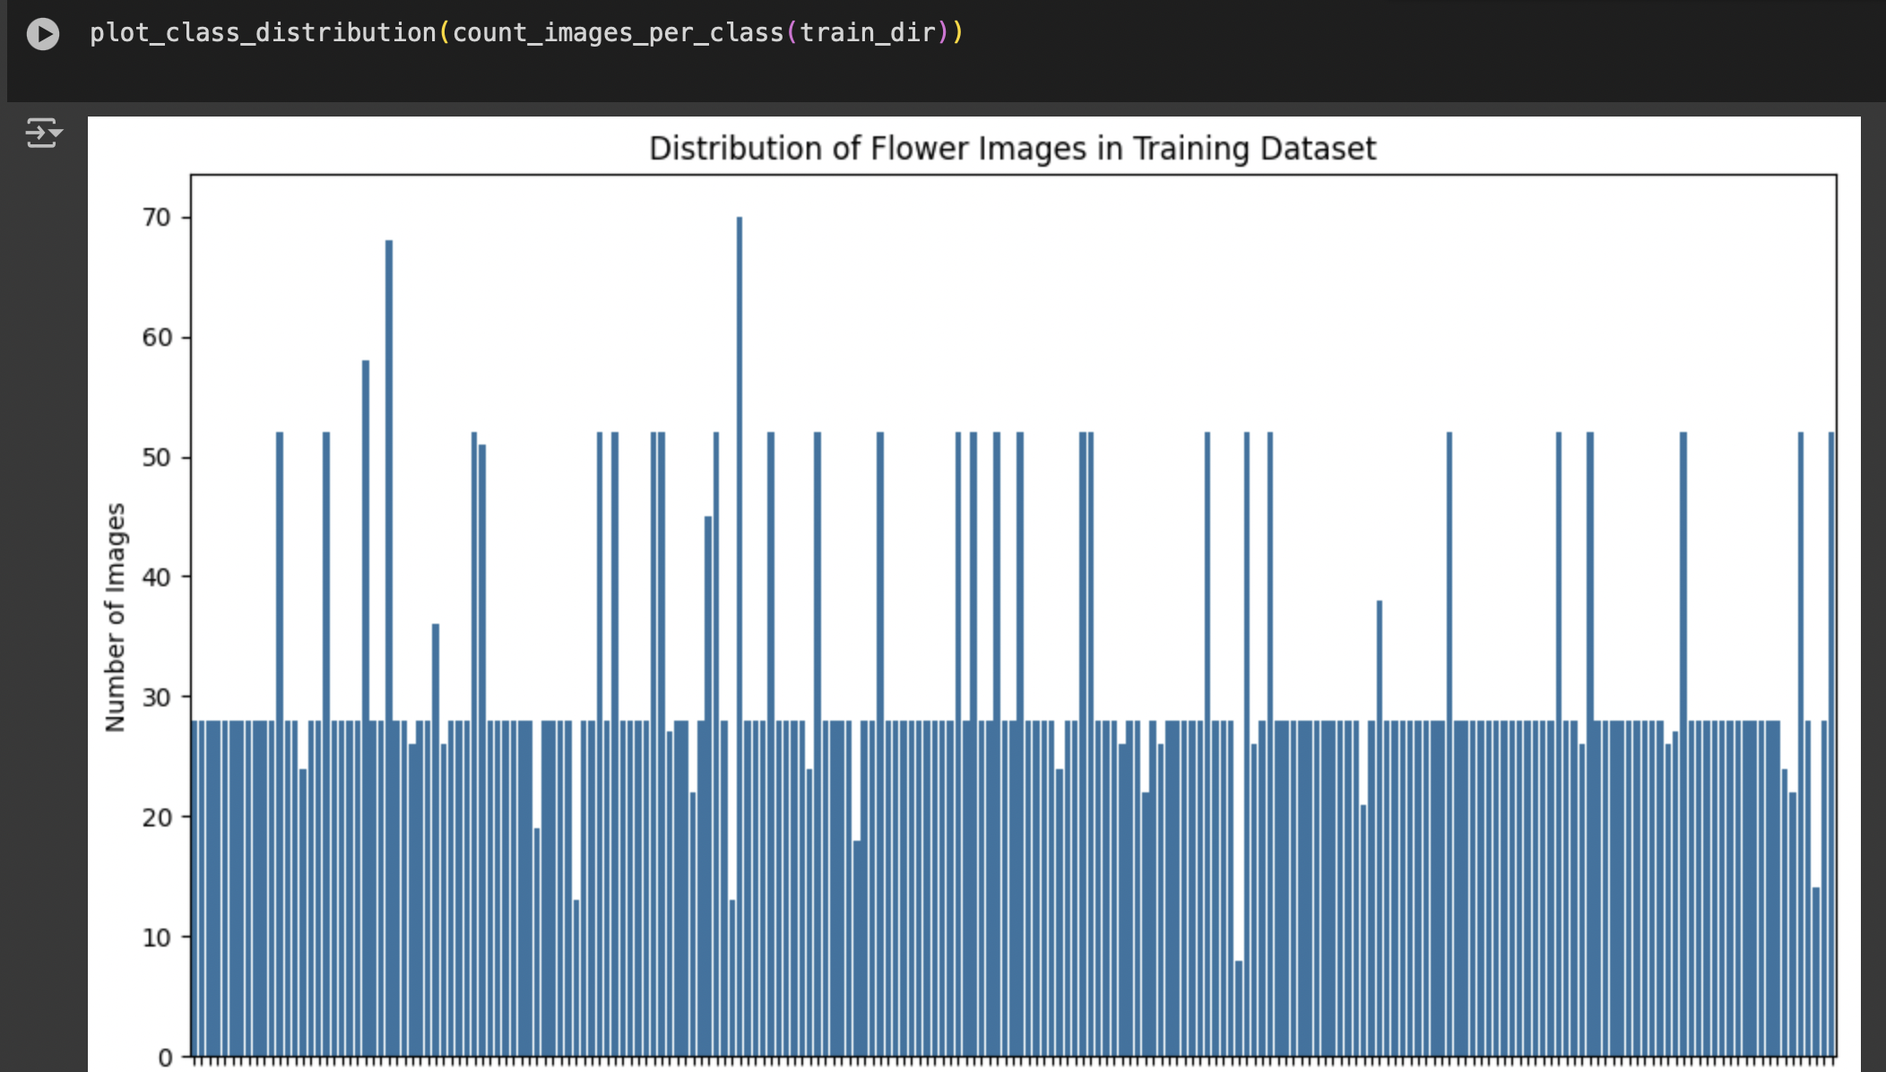
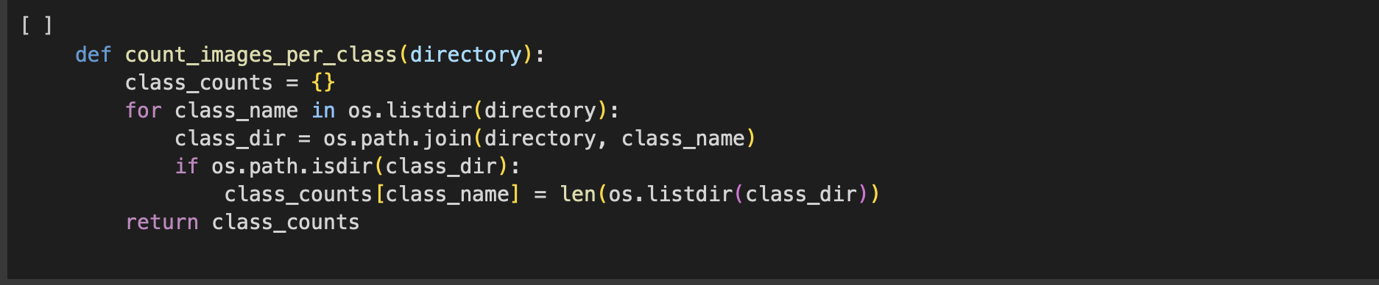
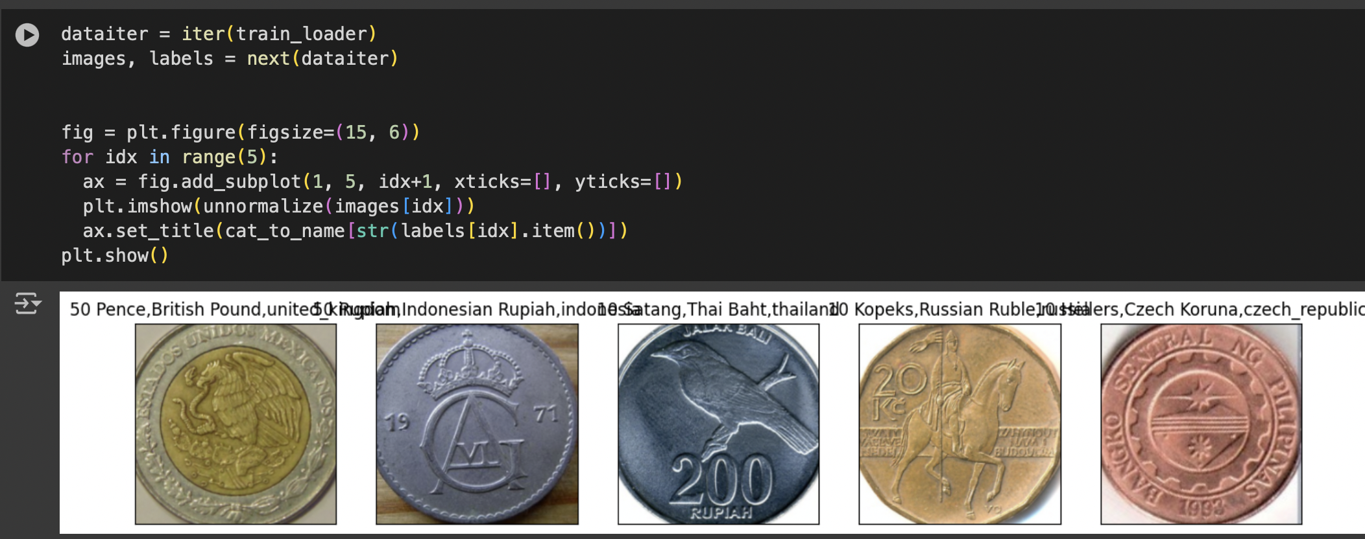
Now plot the sample images to see the inputs
Also To check the distribution of train input data I have made a function to check the image count per class and use the function plot_class_distribution
To plot it
Here one can see the data is not balanced so if we make a model with this data the model parameters will be
Biased on the oversampled data classes
To handle that we need to do data augmentation

Slide 8
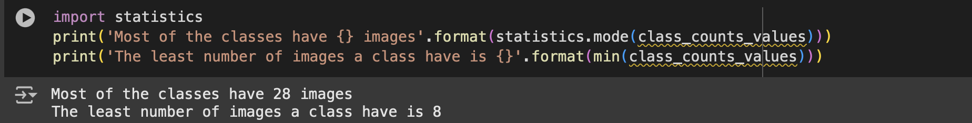
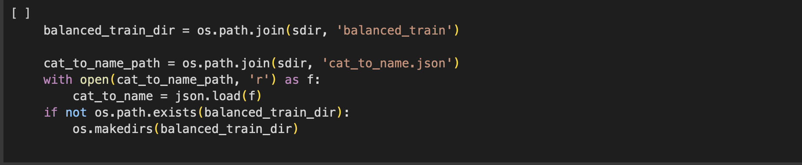
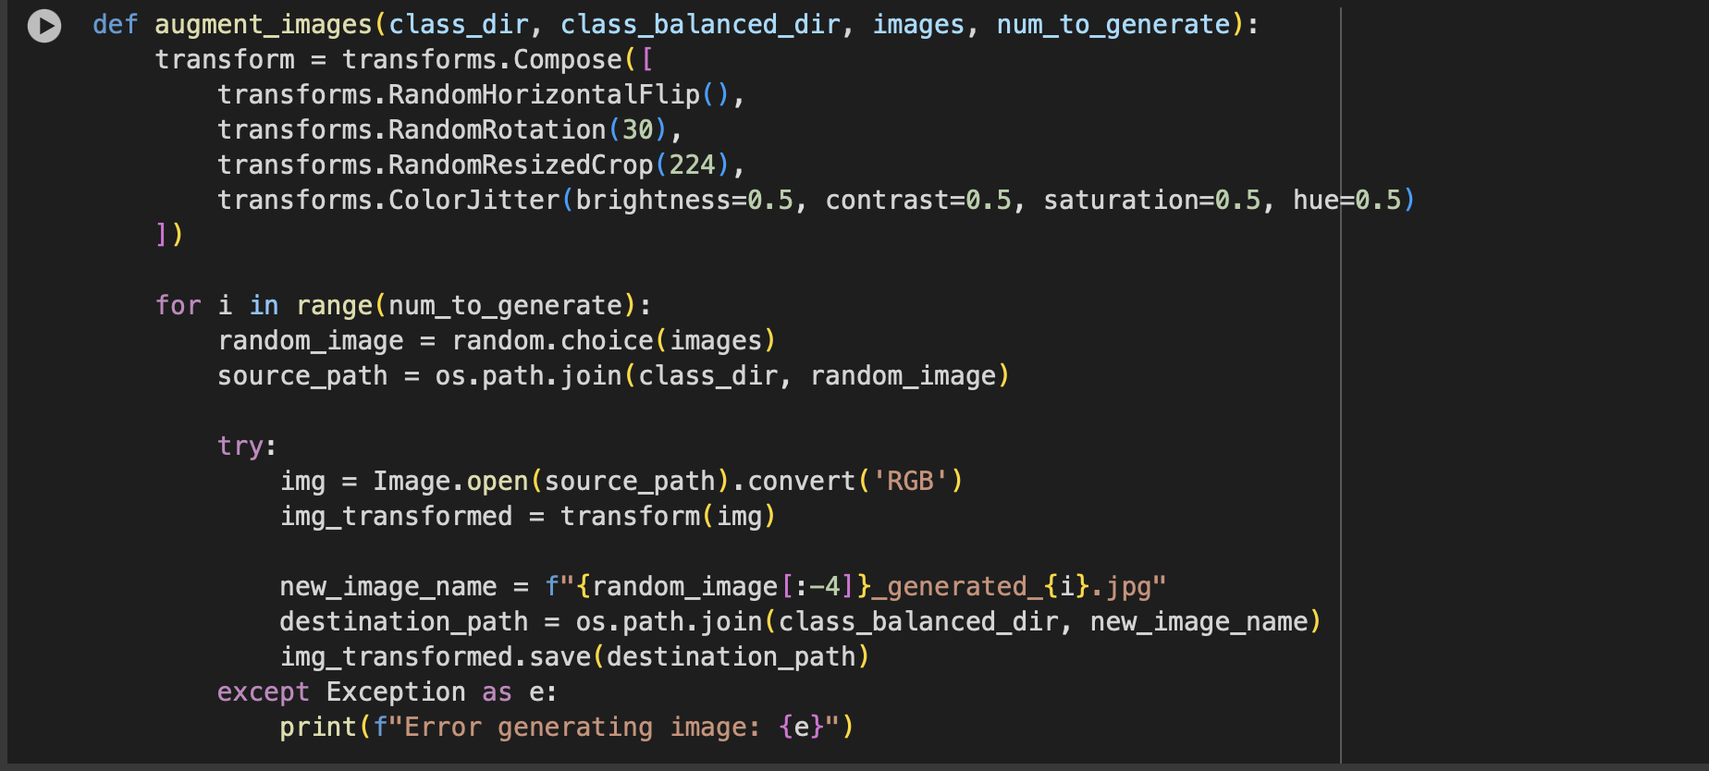
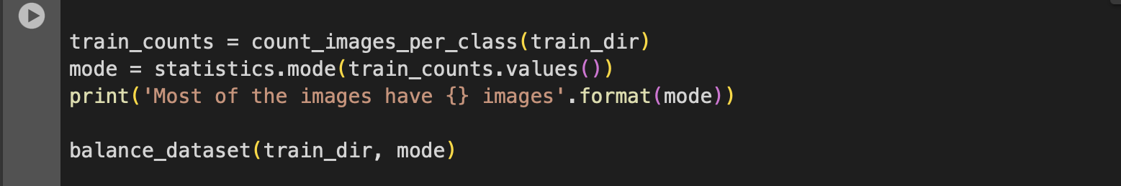
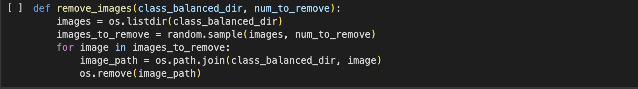
Now to complete data Augmentation. First one need to find out
The best possible image count per class I have used mode function
To calculate the most count of images in a class in the train dataset
After finding out the mode need to defined some functions
Generate image
This will choose an image randomly in the class to create a new
image and apply flip, rotation, crop, and color functions to create
an new image till the count is same as the mode.
Remove Images
It will randomly pick the image from the current class and
Remove the image from the dataset till the count is same as the
mode

Slide 9
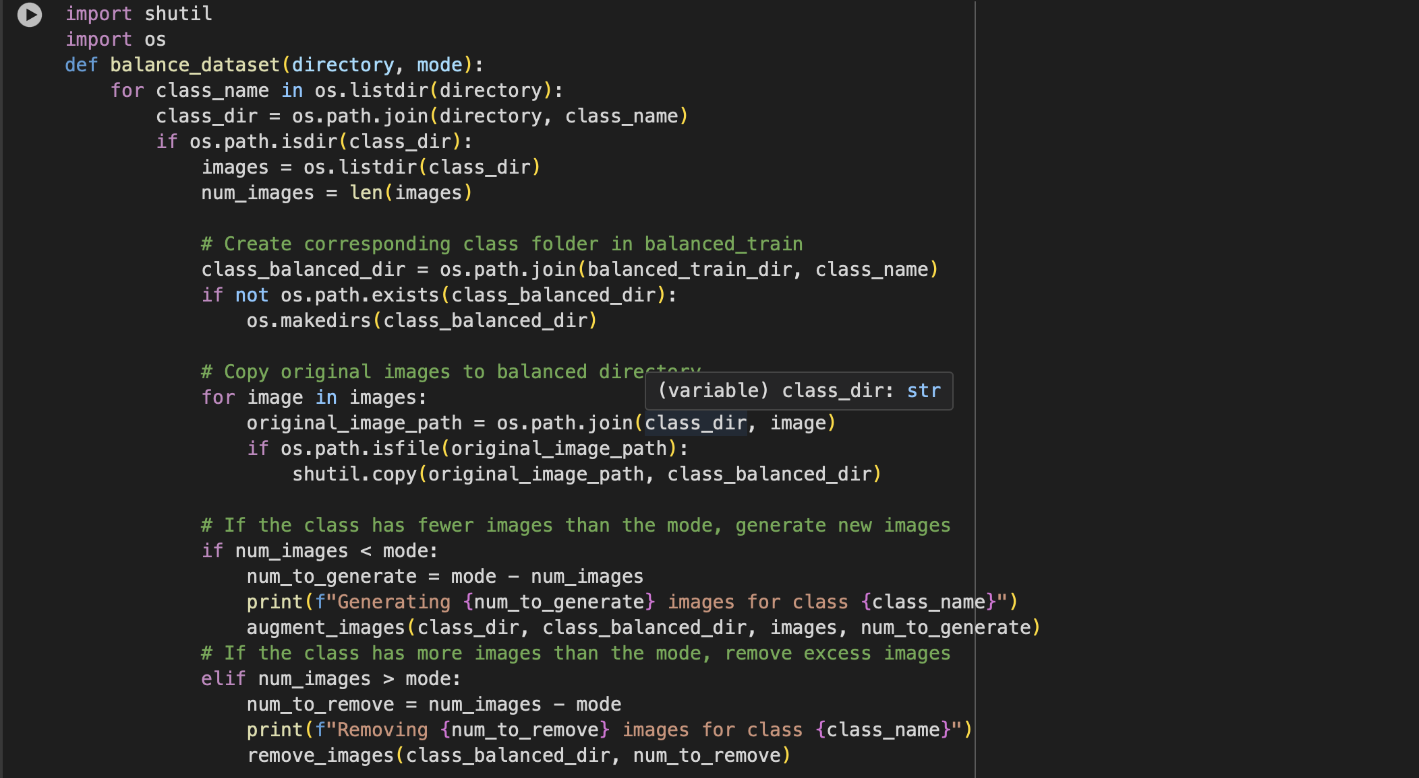
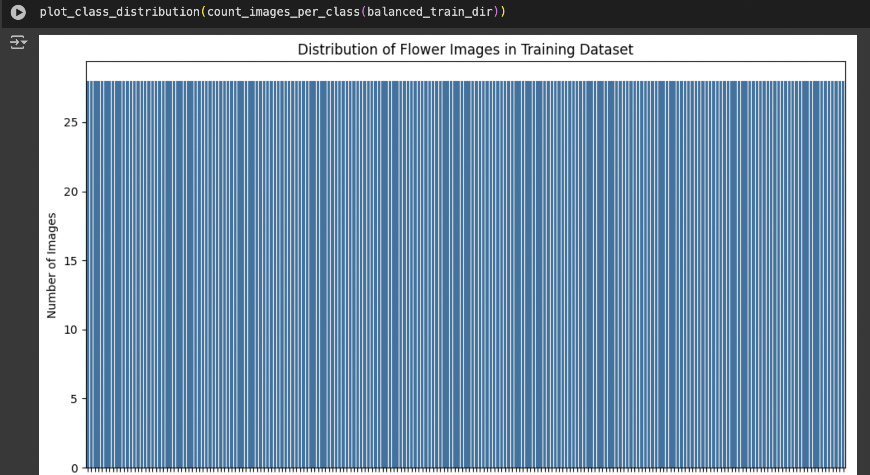
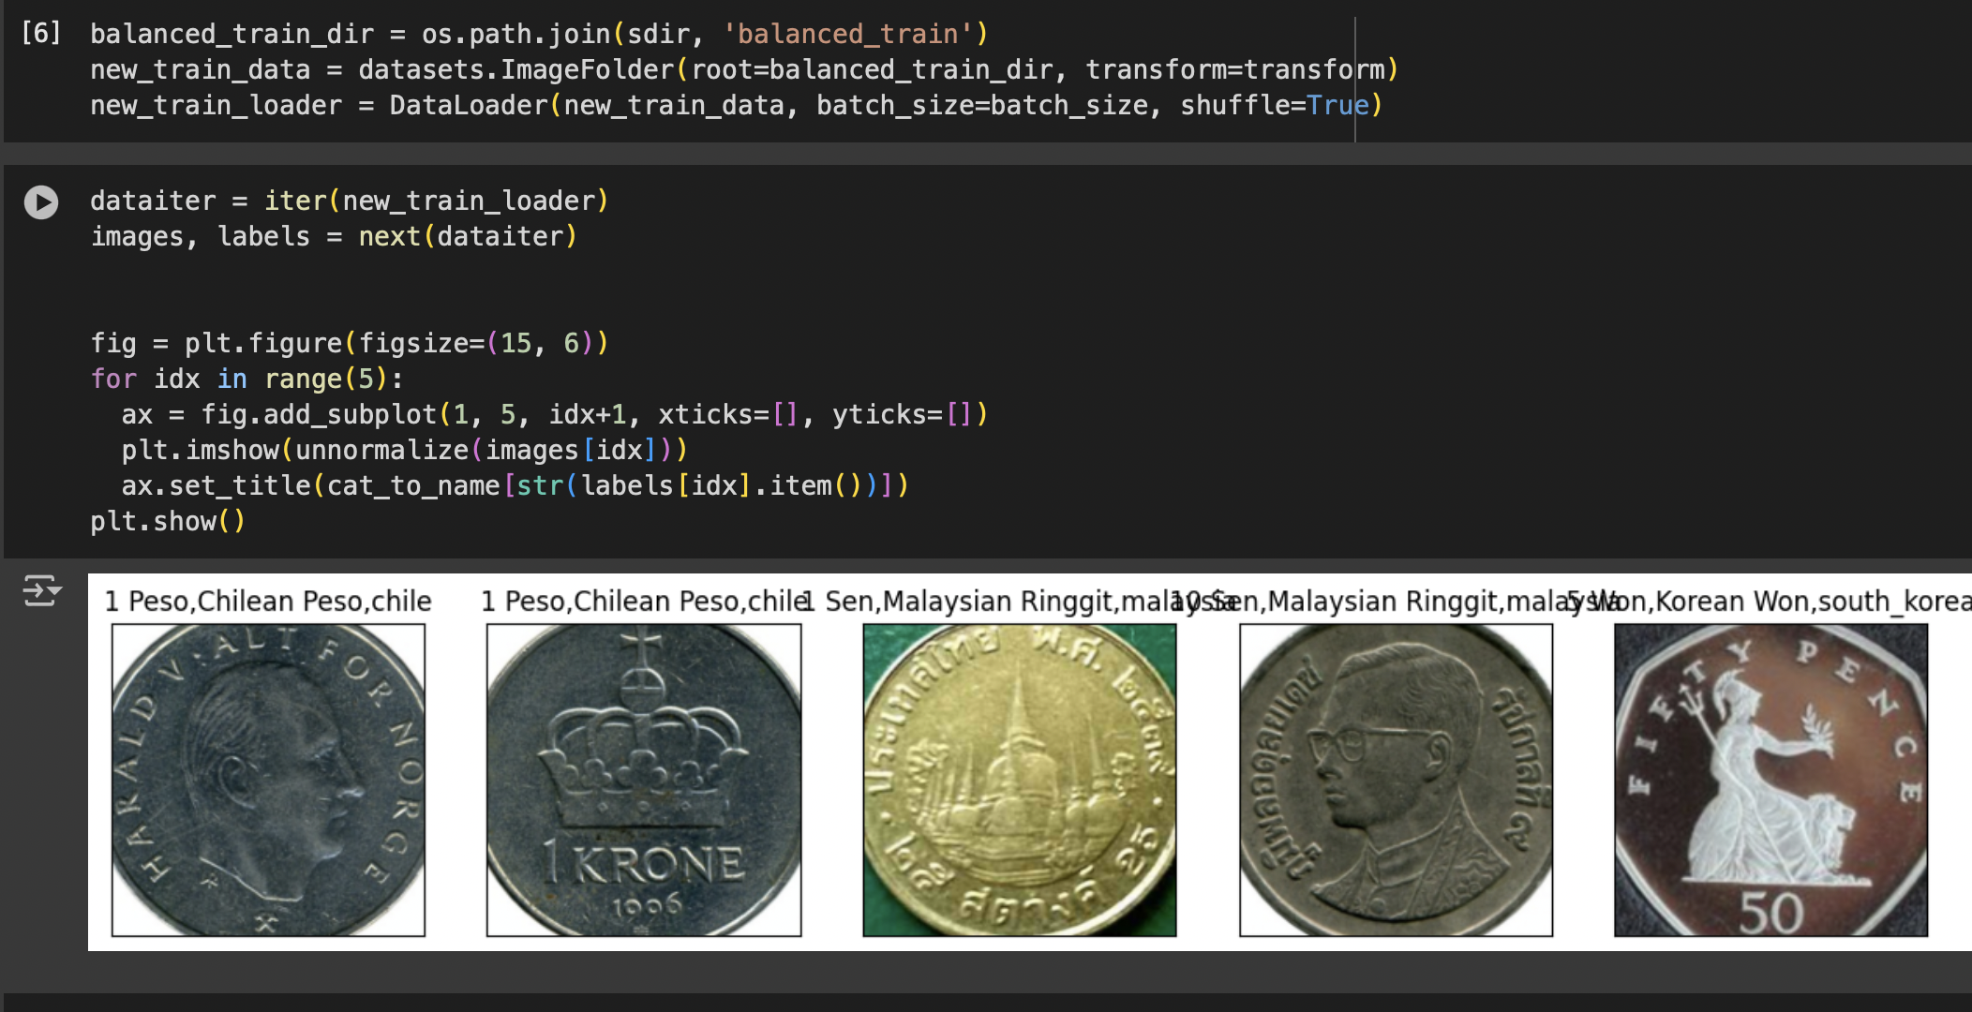
Now define the balance function which will take the count,
and data directory to make the balance dataset and put the new
Balanced data into new directory using predefined functions
Remove and generate.
After the creation of the new directory make the dataloader with
The new directory and plot the sample images and class distribution

Slide 10
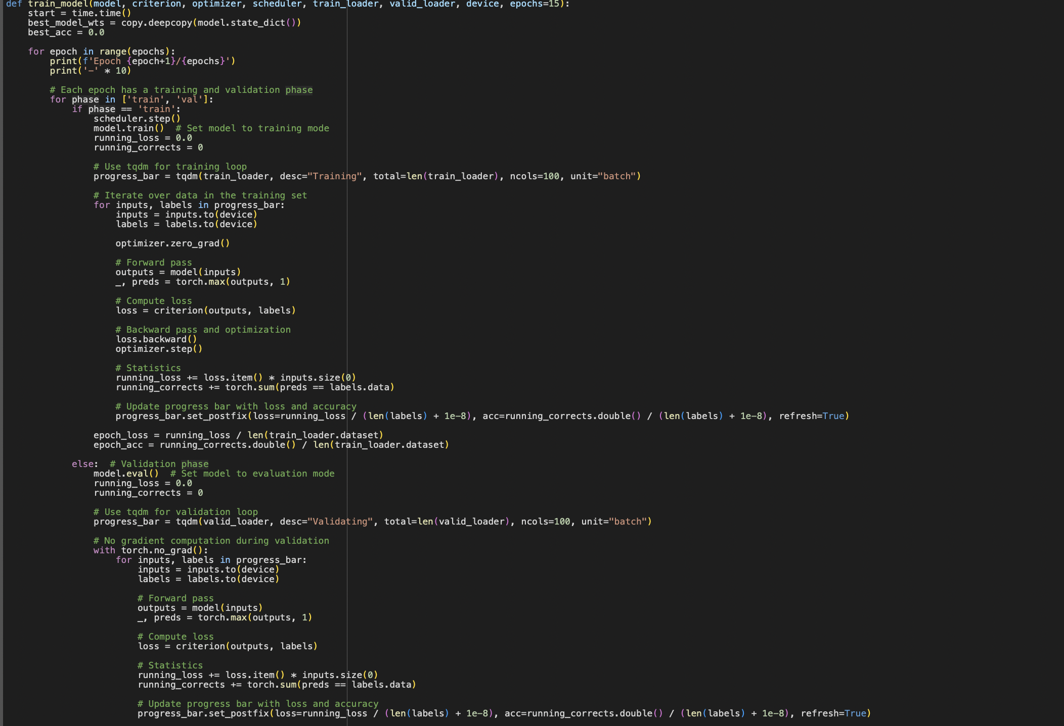
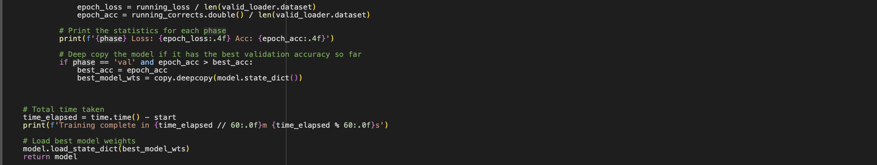
Now as the data is balanced it can be used to train the model
As we are not creating a new model, we need to call the pretrained
And freeze the parameters so we will not change them just add the
Last output layer on top of the pretrained model’s output layer as a
Fully connected layer.
Now defined the training loop that will update the last layer’s
Parameter and use the parameters to find the model’s accuracy
On the validation data

Slide 11
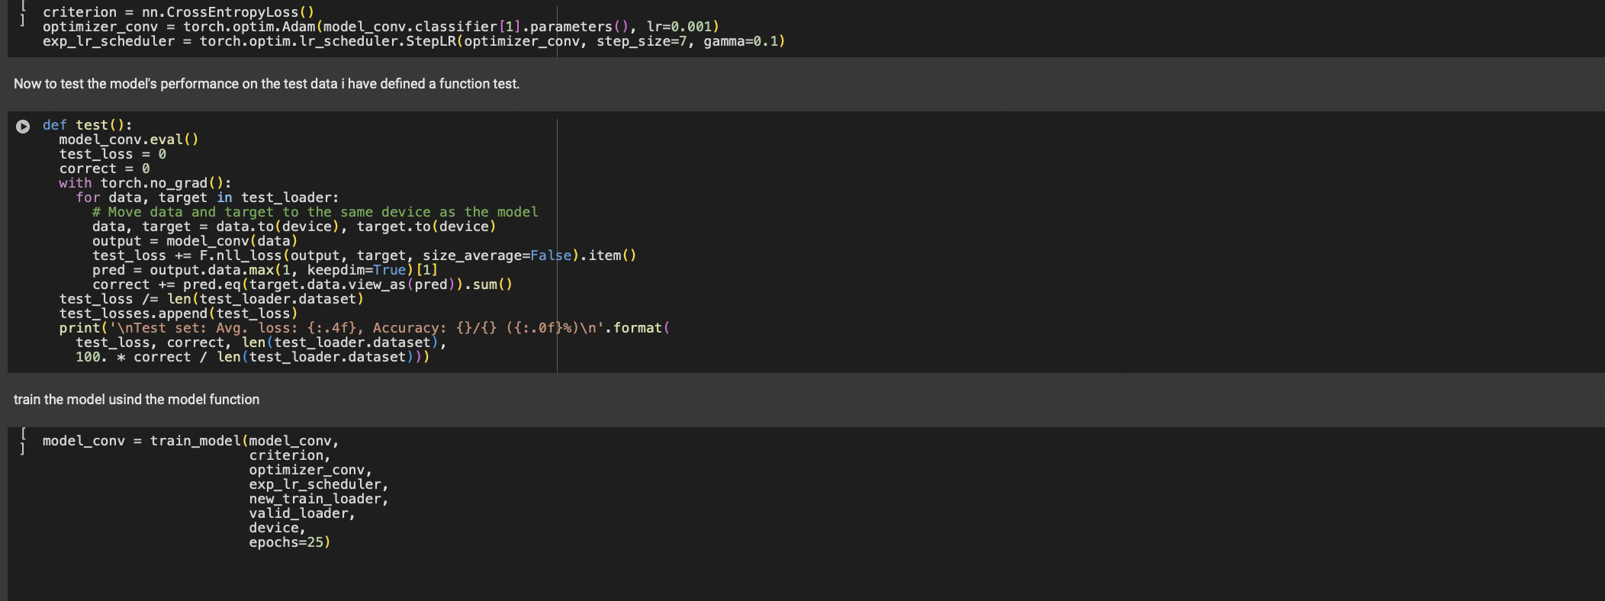
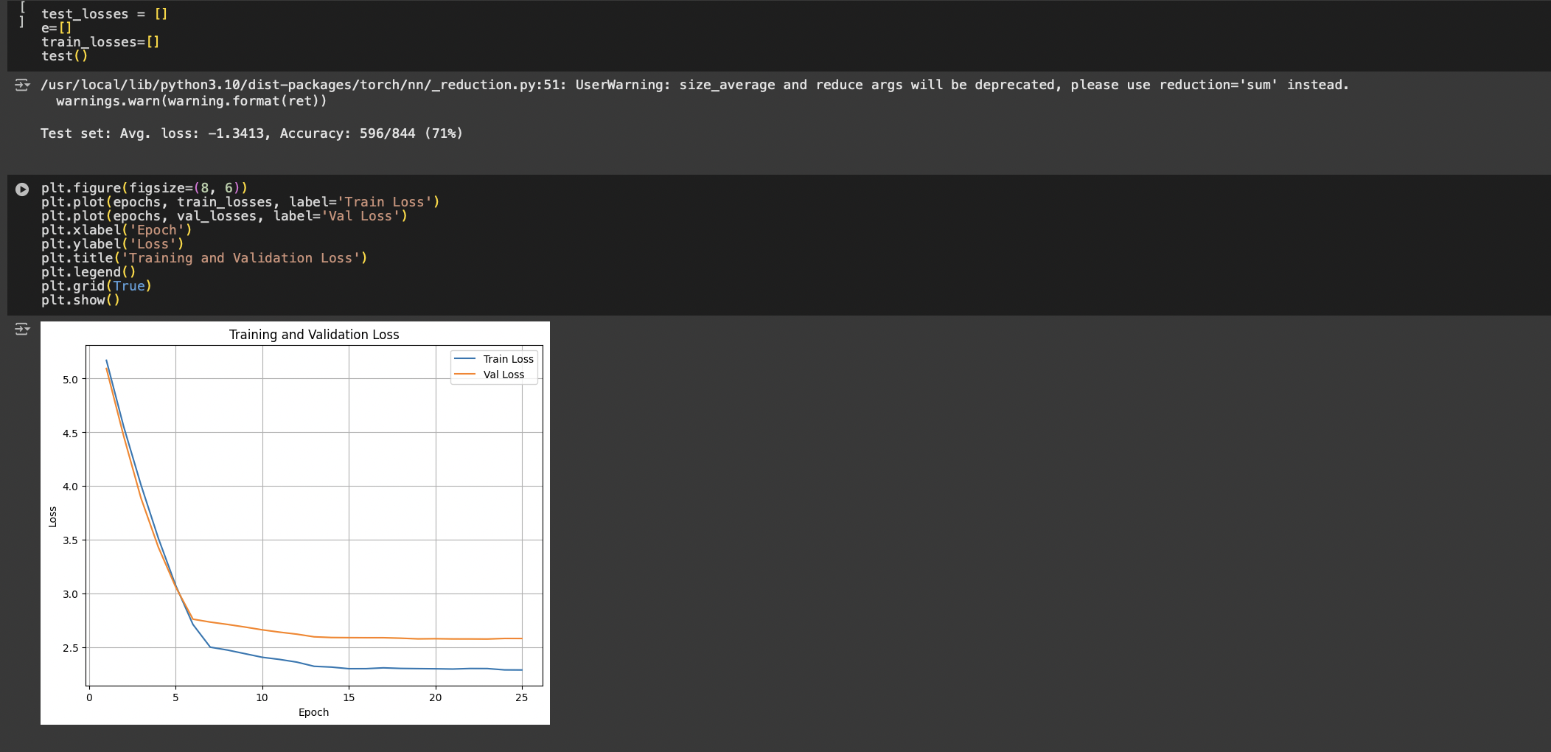
Define the loss function, optimizer and the learning rate for the optimizer then call the training and testing loop
Get the values of the losses and plot them using the matplotlib’s line plot
The accuracy I got from the model on the testing data is 71%
This accuracy can be improved by changing the number of images per class as the mode of the images was only 28 the model will be able to perform
better if the count of images per class is more than 90.

Slide 12
Thank you

